Slide 1
The University of Queensland
School of Earth and Environmental Sciences
esys-escript
Lutz Gross
E-mail : l.gross@uq.edu.au

Slide 2
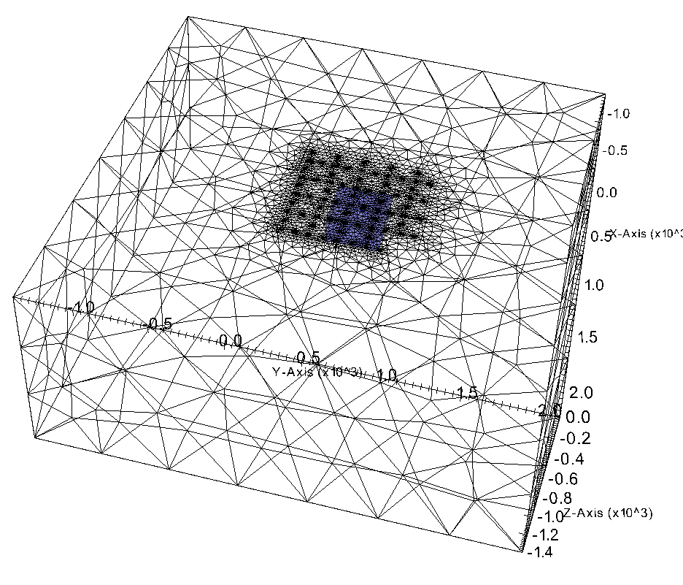

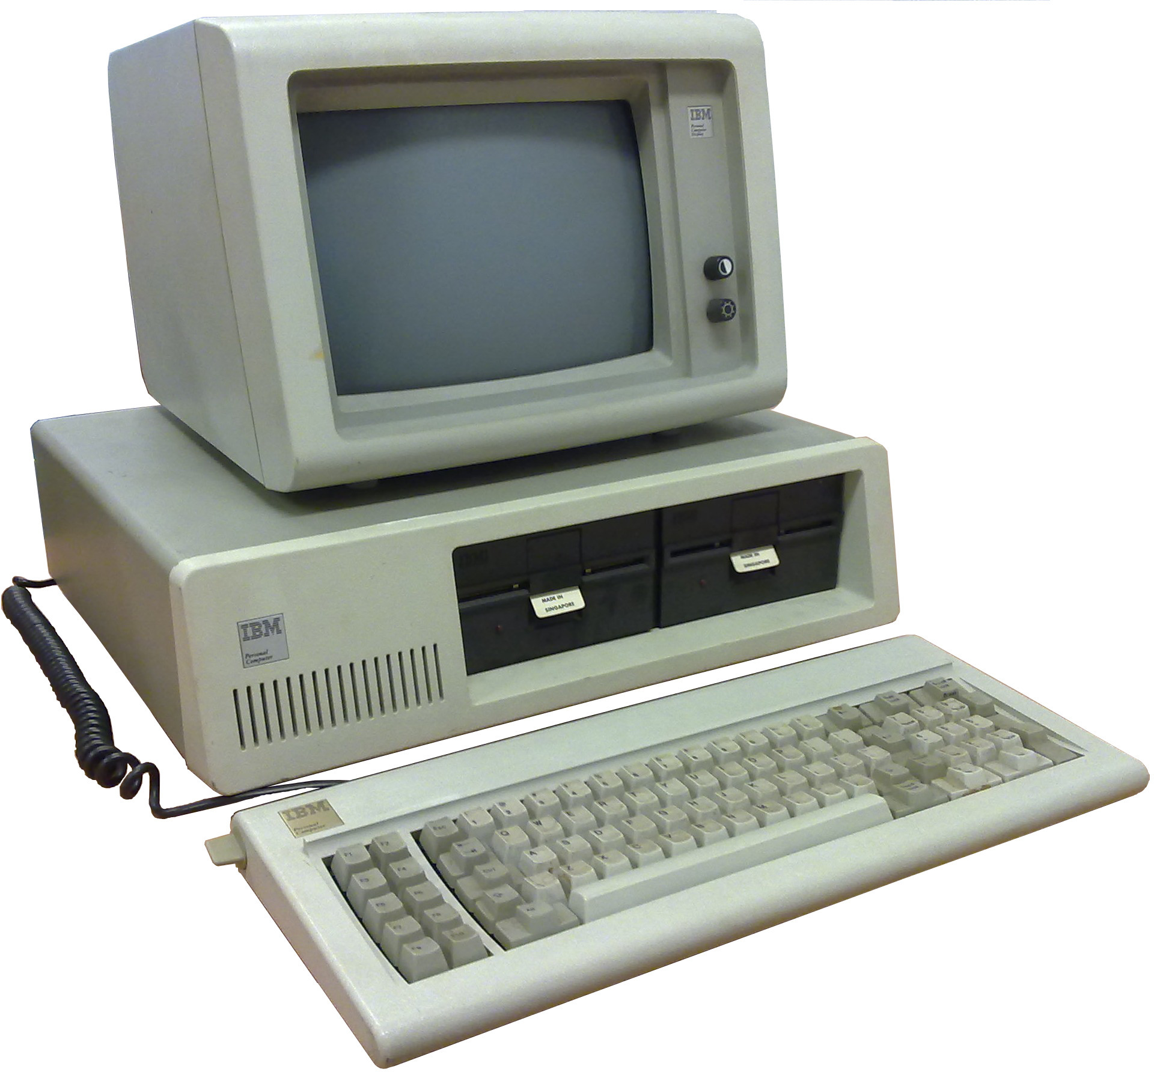
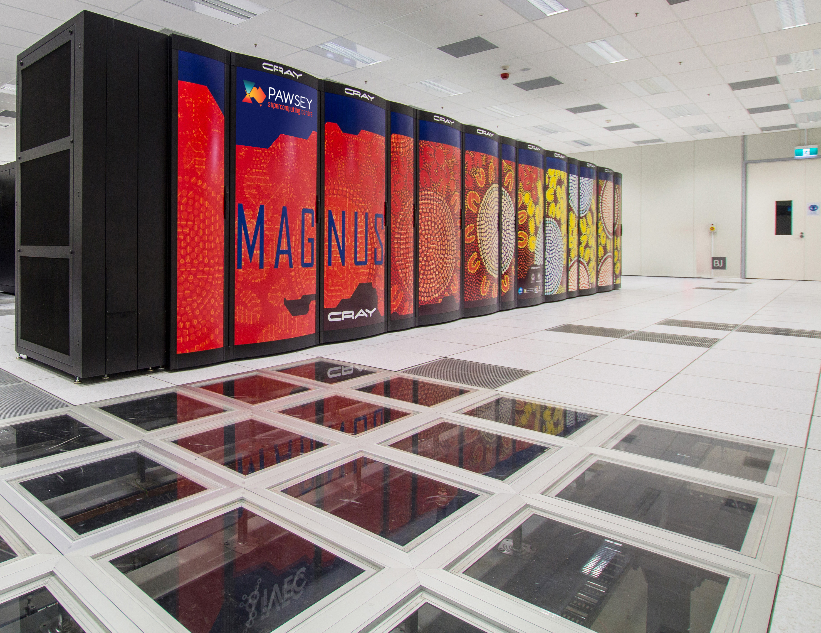
esys-escript
Geometry
Mathematical Model
esys-escript: scripted Model Implementation
from esys.escript import *
import esys.escript.unitsSI as U
Q=10*U.W/U.m**3; K=1.7*U.W/(U.m*U.K); rhocp=1.5*U.Mega*U.J/(U.m**3*U.K)
# … time step size:
dt=1.*U.year; n_end=100
# … 40 x 20 grid on 10km x 5km
mydomain=Rectangle(40, 20,l0=10*U.km, l1=5*U.km)
x=mydomain.getX()
# … create PDE and set coefficients:
mypde=LinearPDE(domain)
mypde.setValue(A=K*kronecker(mydomain), D=rhocp/dt, q=whereZero(x[1]-5*U.km))
# … initial temperature is a vertical, linear profile:
T=0*U.Celsius+30*U.K/U.km*(5*U.km-x[1])
n=0
while n<n_end :
mypde.setValue(Y=Q+rhocp/dt*T, r=T)
T=myPDE.getSolution()
n+=1
saveVTK(“u%s”%n, temperature=T, flux=-K*grad(T) )
print(“Time “,n*dt,”: min/max temperature =”,inf(T), sup(T))
Desktop
Parallel Supercomputers

Slide 3

esys-escript
Module for solving partial differential equations (PDEs) in python
Open source under Apache 2.0 license
Started back in 2003
Part of the National Collaborative Research Infrastructure Strategy for Earth Sciences

Slide 4
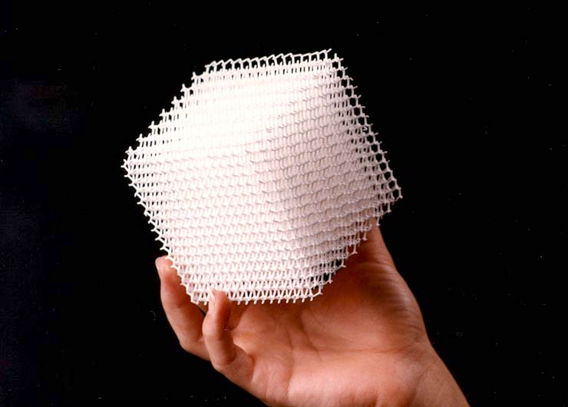

esys-escript (cont.)
  Modeling with PDEs
  Rapid prototyping of new models
  Easy of Use
  “Supercomputing for the masses”
  Open Source
  Programming in python

Slide 5
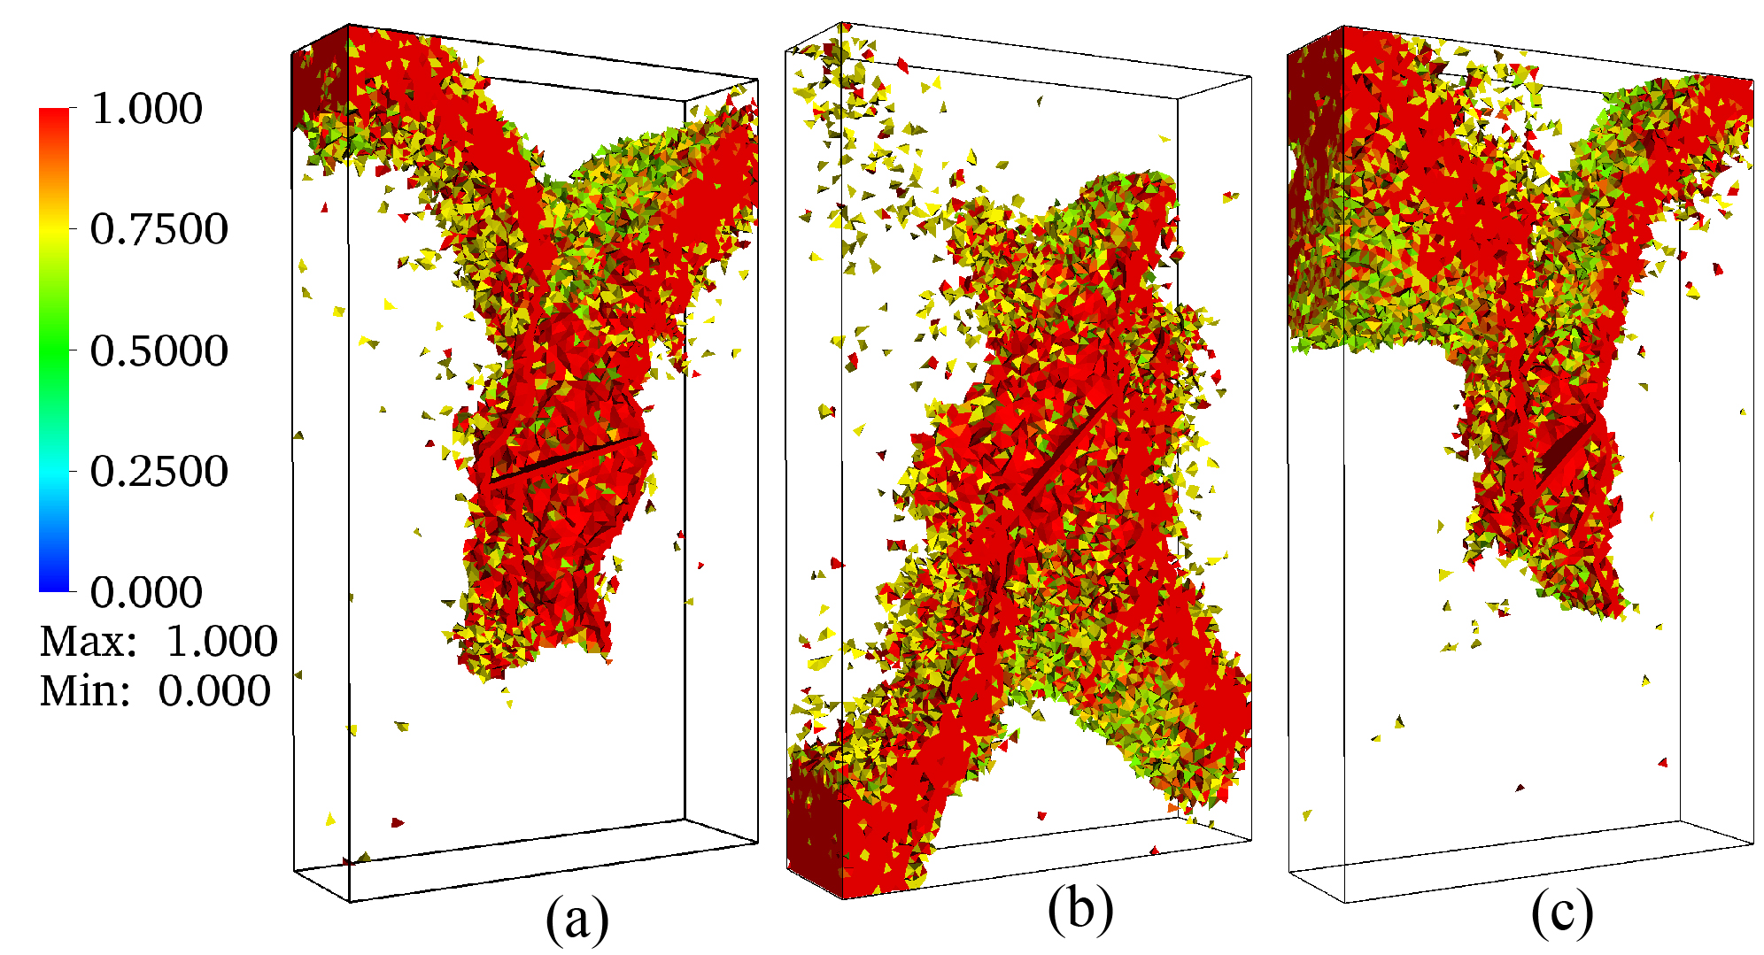
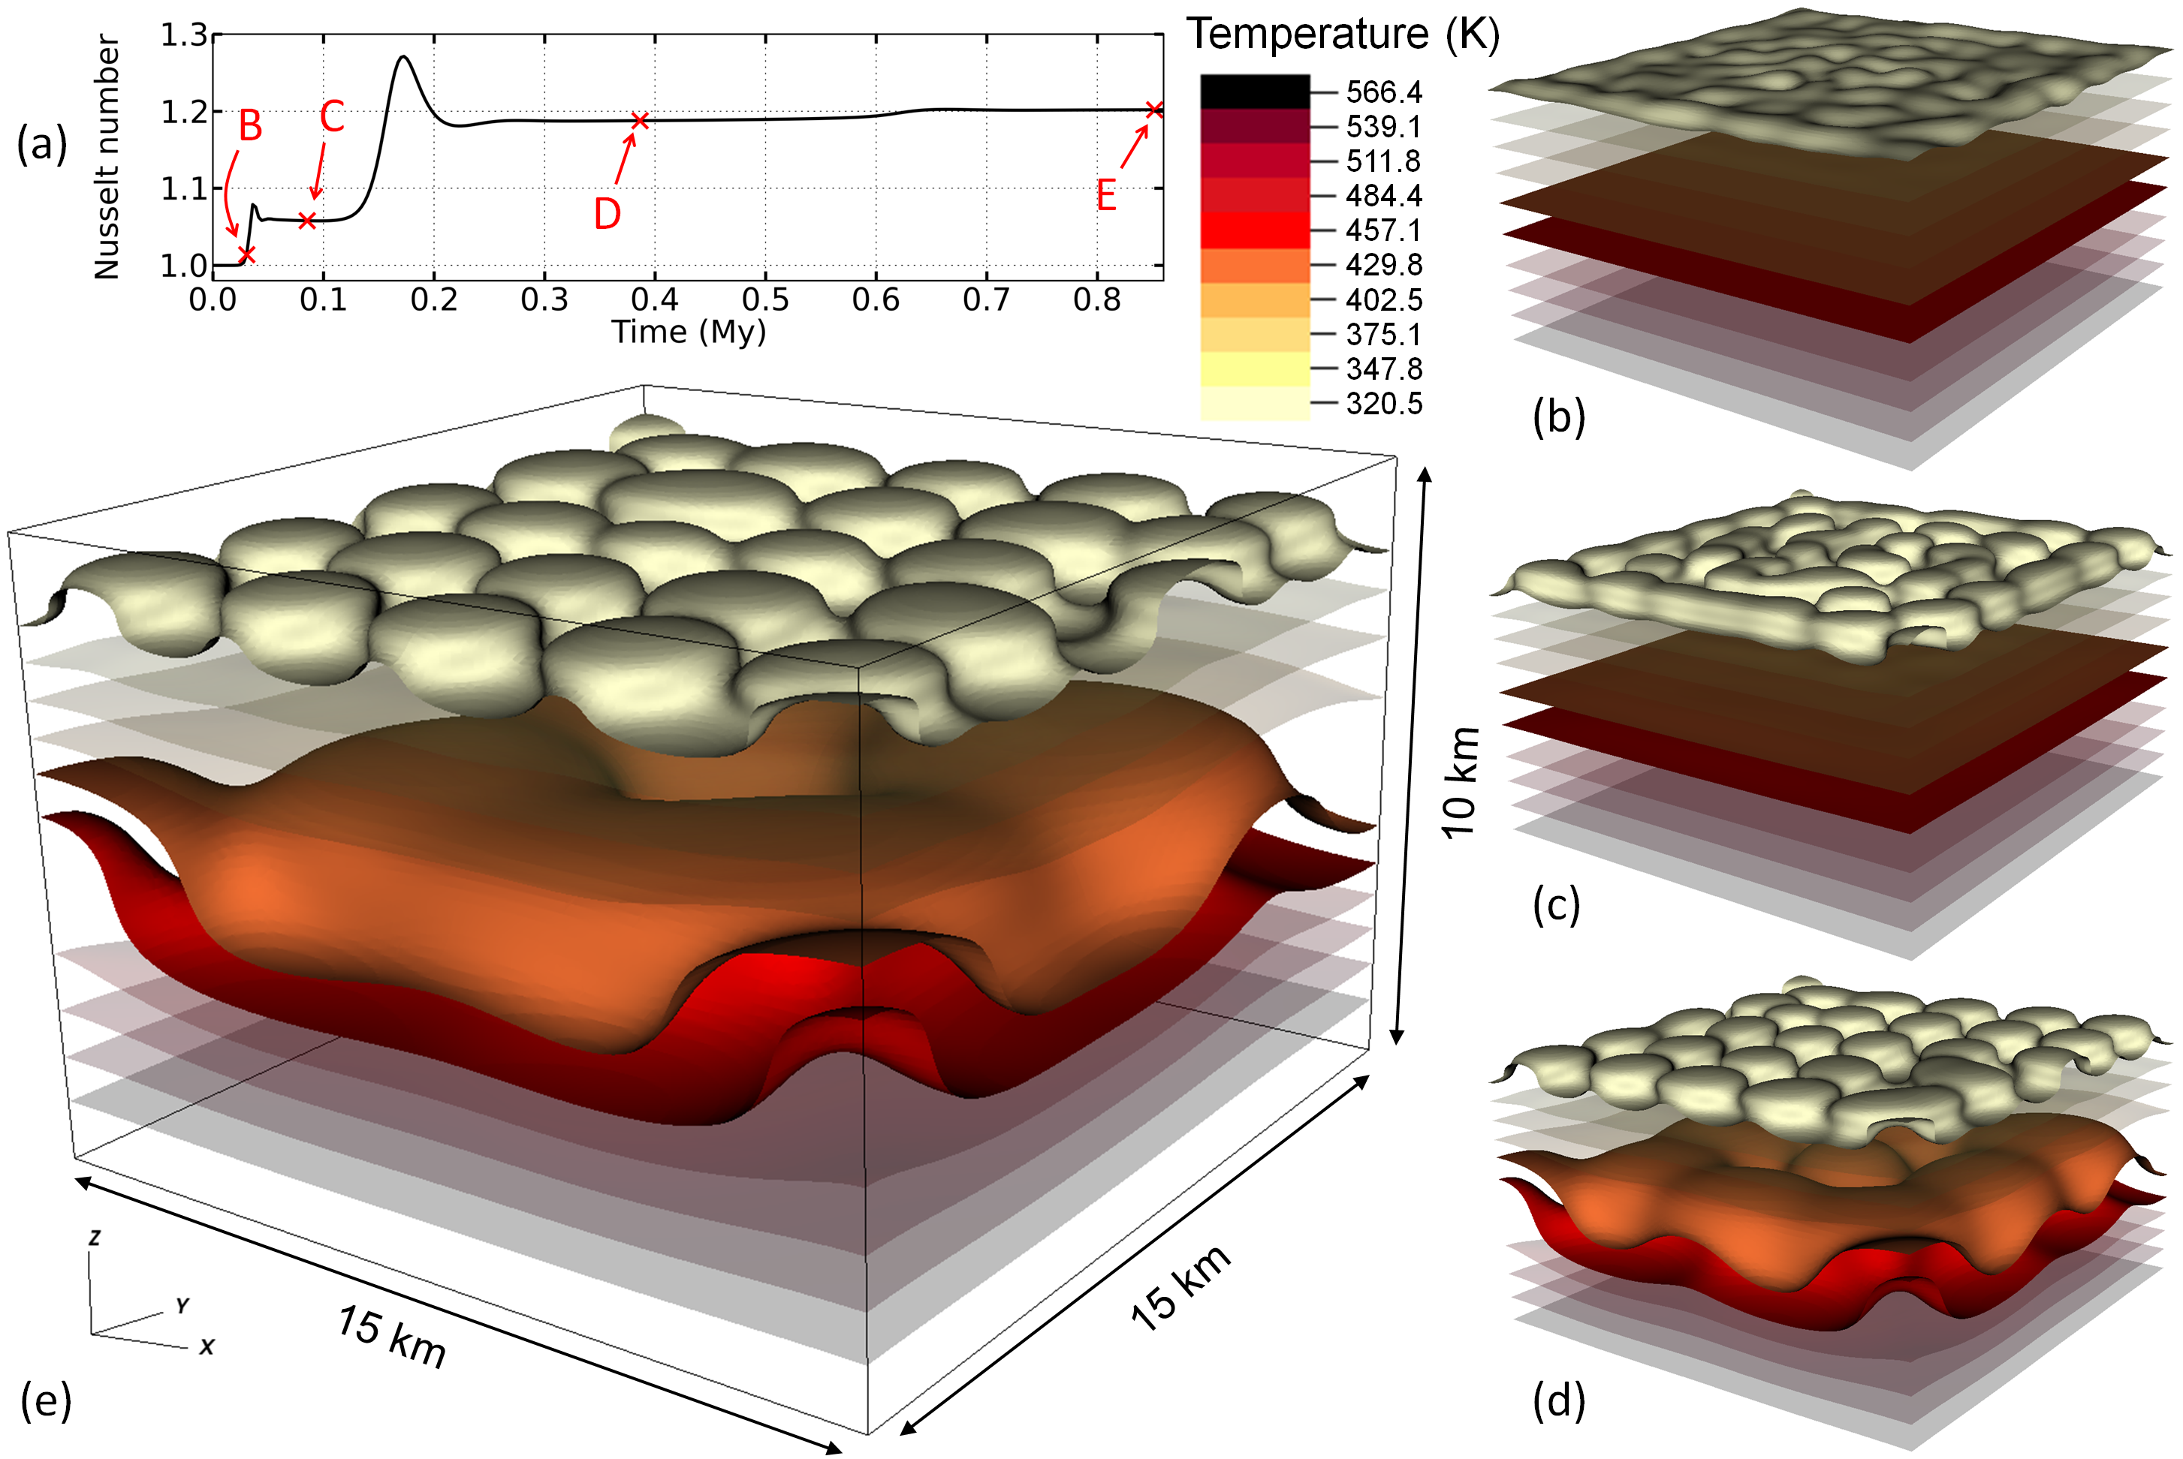
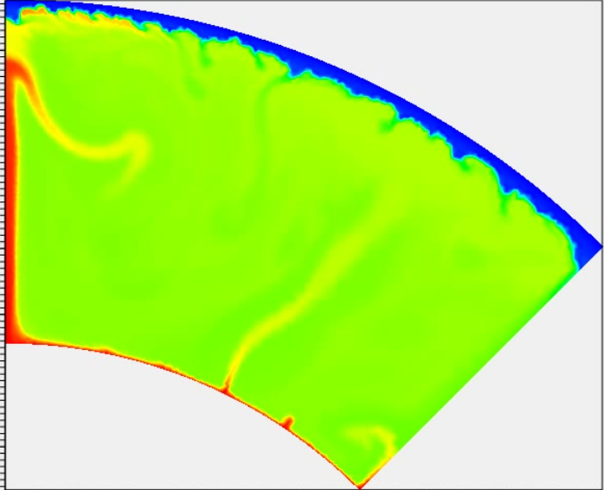
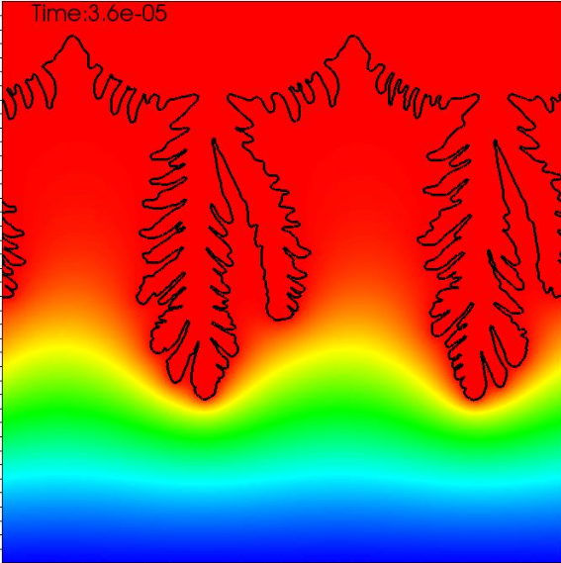
Some applications
Mantel Convection
Pores Media Flow
Geomechanics
Geophysical inversion
Earthquakes
Volcanoes
Tsunamis
...

Slide 6
Downloads
Software: current version 5.9
https://github.com/esys-escript/esys-escript.github.io
  Installation from source
  Also Q&A, bug reports
Binary
  Anaconda: https://anaconda.org/conda-forge/esys-escript
  Debian Package manager
Users’ guide: https://github.com/esys-escript/esys-escript.github.io/blob/master/user.pdf
API Documentation: https://esys-escript.github.io/api.html

Slide 7
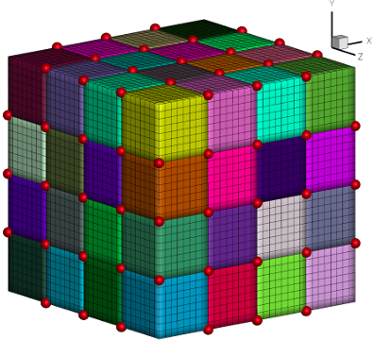
Discretization Approach
Finite Element Method (FEM)
  Grids and unstructured meshes in 2D and 3D
approximate solution PDEs in weak form
  by continuous, piecewise linear approximation
  Solve discrete problem with sparse matrix
    With direct, iterative, multi-grid solver
Parallelization on large number of cores (>25000)
  Use Domain decomposition
  Hidden from then user

Slide 8
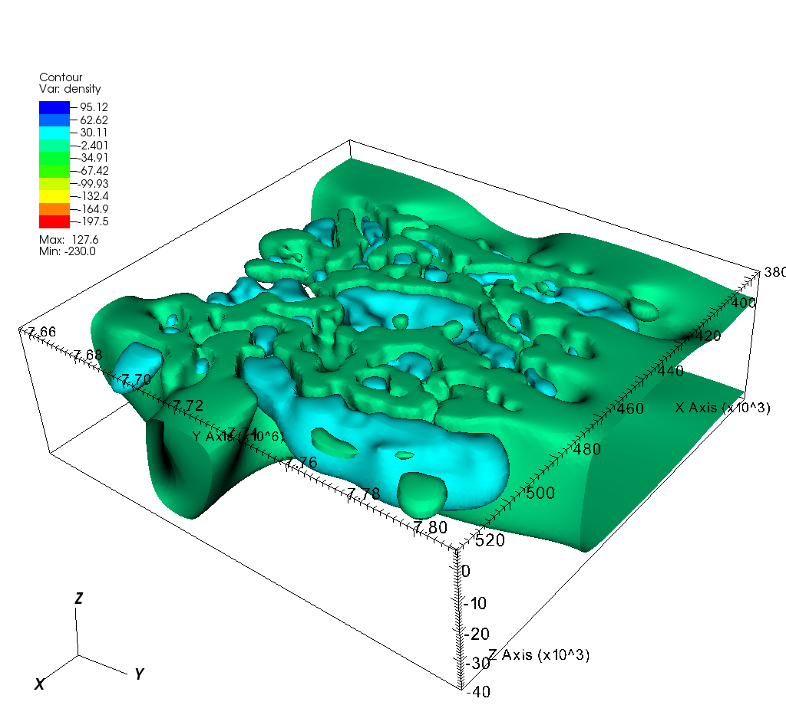

Structure
Visualization
paraview, VisIt, mayavi
esys.escript
Tools box
Coefficients & Solutions
PDE Template
PDE Template
Domain
Python
C++
Data handling
Matrix Assemblage
Discretization
Sparse Matrix Solver
eg.TRILINOS
Parallelization: MPI & OpenMP

Slide 9
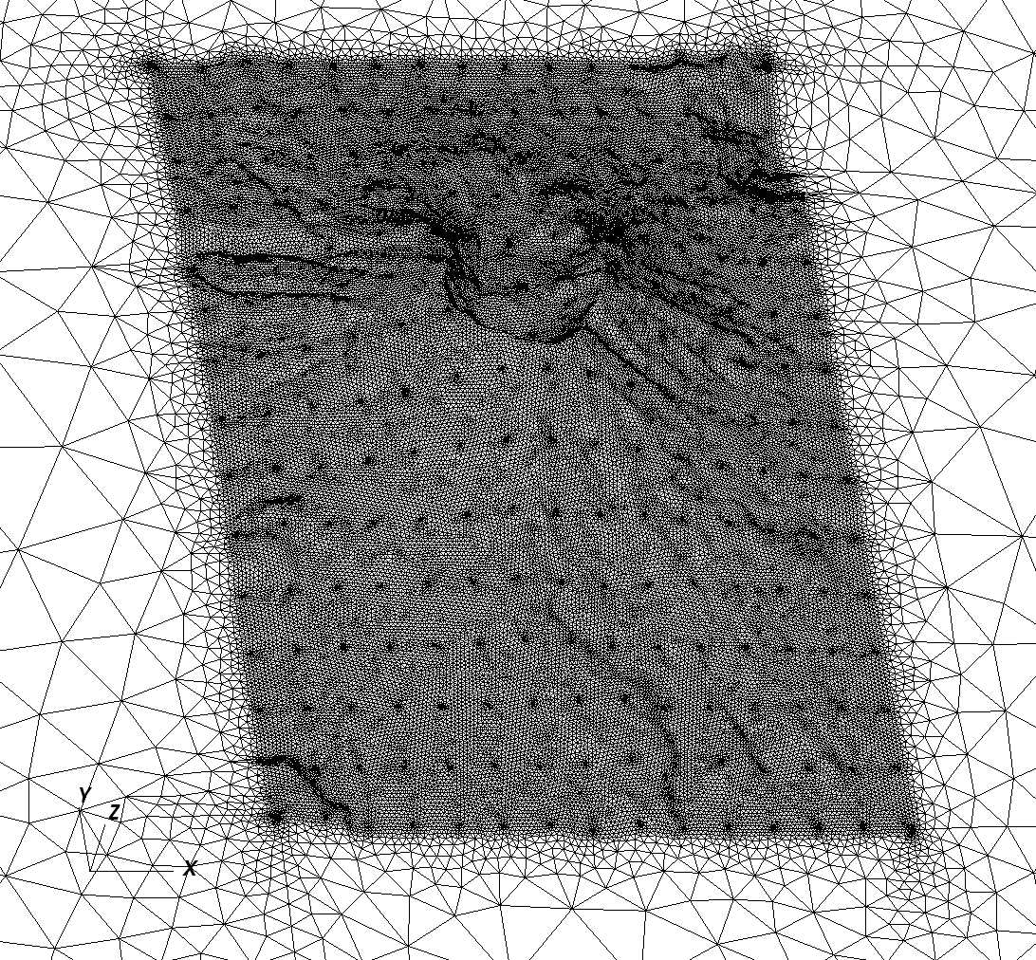
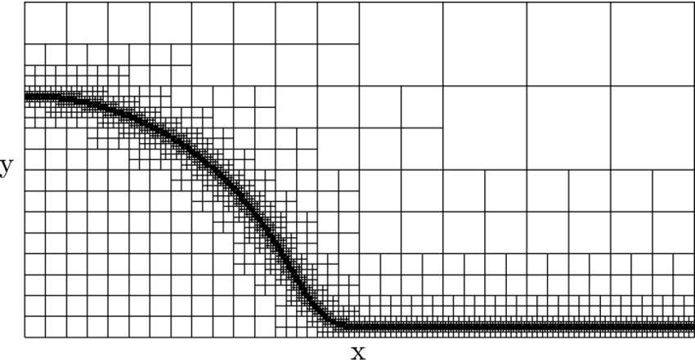
Discretization Models
Available through different modules:
  esys.finley: General FEM discretization:
    Unstructured meshes 2D and 3D
    hexahedron, tetrahedron, triangles, rectangles,
    Piecewise linear or quadratic
  esys.ripley: rectangular grids in 2D and 3D
  esys.dudley: piecewise linear tetrahedron & triangles
  esys.specley: Spectral Element Method (SEM)
    for wave propagation
    Higher order polynomials
  Under construction: esys.oxley:
    hierarchical grids with local refinements

Slide 10
PDE Template
general linear PDE for unknown solution u :
‘generalized’ flux:
conservation equation:

Slide 11
Python Script Structure
  Definition of the domain
  Definition of PDE coefficients
  Obtain Solution
  Post-processing
    Get solution at points → recordings
    Write to file → visualization
Non-linear,
time-dependent or
inversion

